Slide 1
IOT Auto Temperature Scanner and Mask Monitorfor COVID Prevention
Team:Gen_Z
Team Lead: k.keerthi priya-[19H61A05L5]
Team Members: v.Sahithi-[19H61A05P2]
P.Shriya Rao-[19H61A05N5]

Slide 2
IOT Auto Temperature Scanner and Mask Monitorfor COVID Prevention
The first step to detect covid is by scanning for fever. Also we need to monitor every person for a mask. We have temperature checking systems for every entrances for scanning but manual temperature scanning has a lot of disadvantages.
The personnel are not well trained on using temperature scanner devices.
There is human error in reading values.
Many a times people are not barred from entry even after higher temperature readings or no masks.
The scanning is skipped by the personnel if supervisors are not watching.
Manual scanning system is not suitable for large crowds.
To solve this problem we here propose a fully automated temperature scanner and entry provider system. It is a multi purpose system that has a wide range of applications. The system makes use of a contactless temperature scanner and a mask monitor. The scanner is connected directly with a human barrier to bar entry if high temperature or no mask is detected.
Any person will not be provided entry without temperature and mask scan. Only person having both conditions is instantly allowed inside. The system uses temperature sensor and camera connected with a raspberry pi system to control the entire operation.

Slide 3
Cont..
The camera is used to scan for mask and temperature sensor for forehead temperature. The raspberry processes the sensor inputs and decides weather the person is to be allowed. In this case the system operates a motor to open the barrier allowing the person to enter the premises. If a person is flagged by system for high temperature or no Mask the system glows the red light and bars the person from entry. Also the face and temperature of person is transmitted over IOT to server for authorities to take action and test the person for covid.
Thus the system provides a 100% automated system to prevent the spread of COVID.

Slide 4
Applications
Railways Entry
Airport Entry
Offices Entry
Museums and Amusement Parks
Other Public Places

Slide 5
Advantages
Full Automatic Detection
Automatic Operation

Slide 6
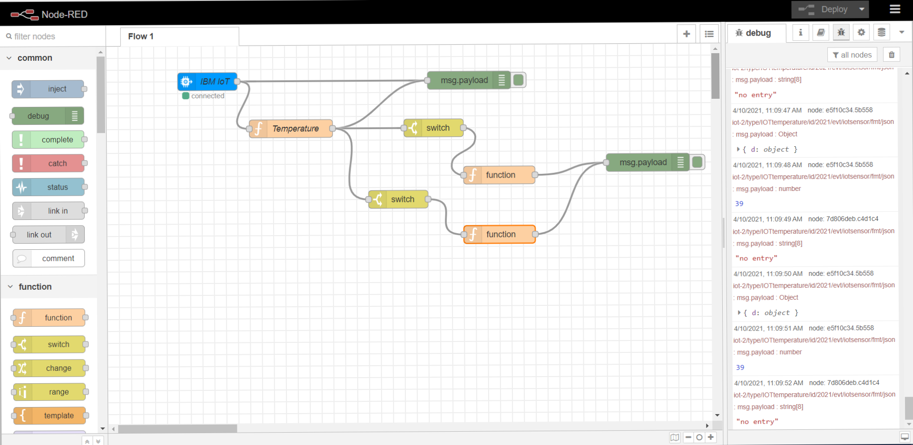
Noded Flow Diagram:

Slide 7
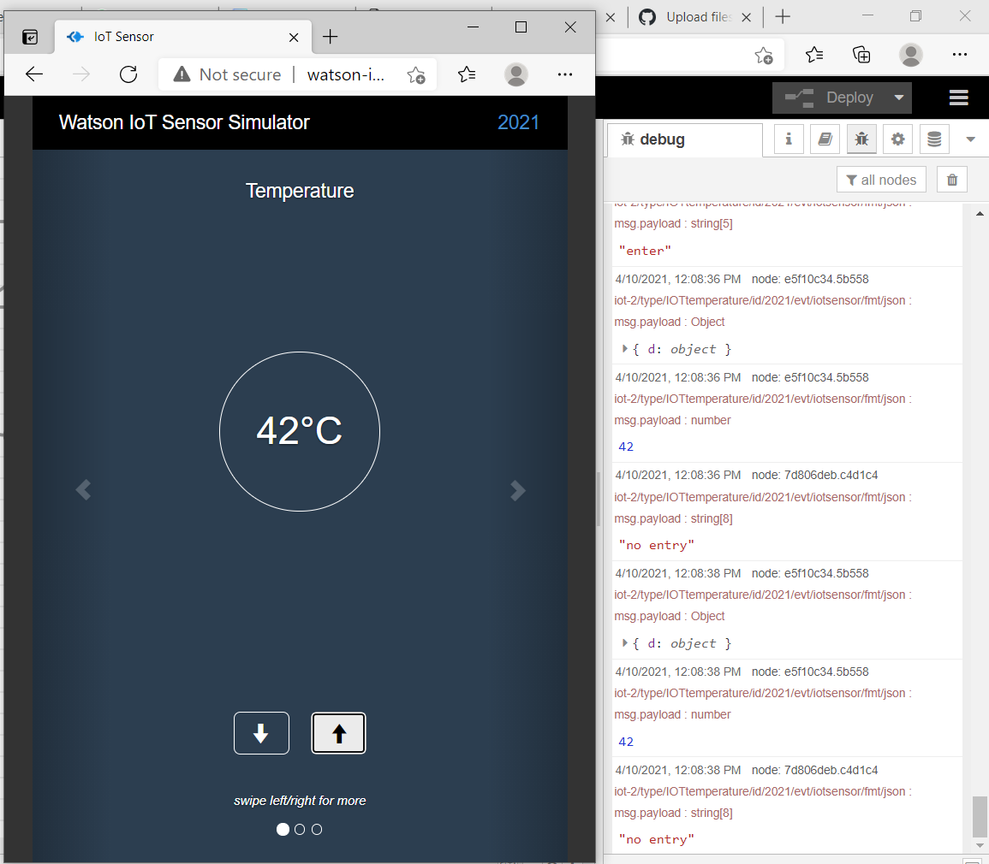
Results

Slide 8
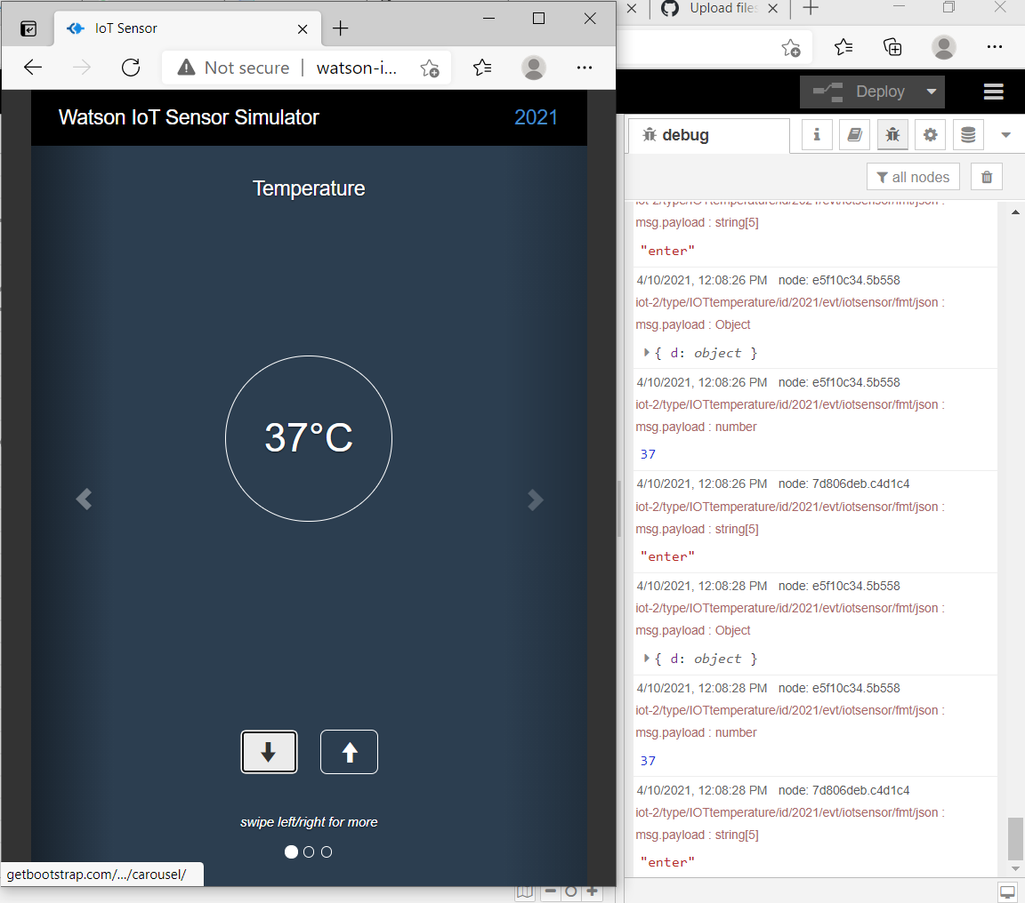
Results

Slide 9
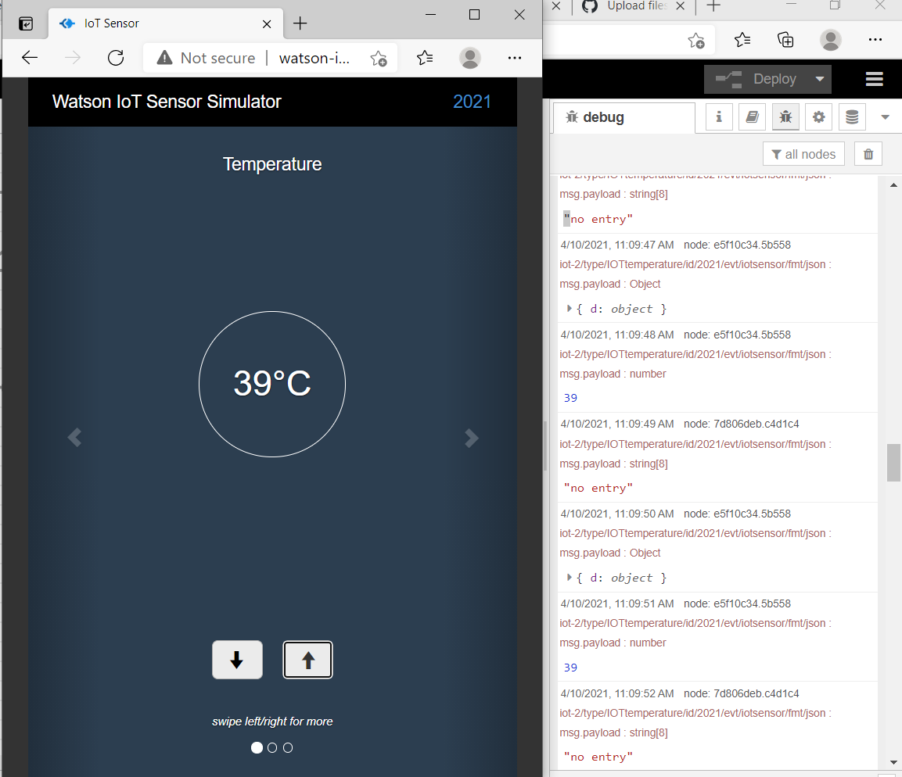
Results

Slide 10
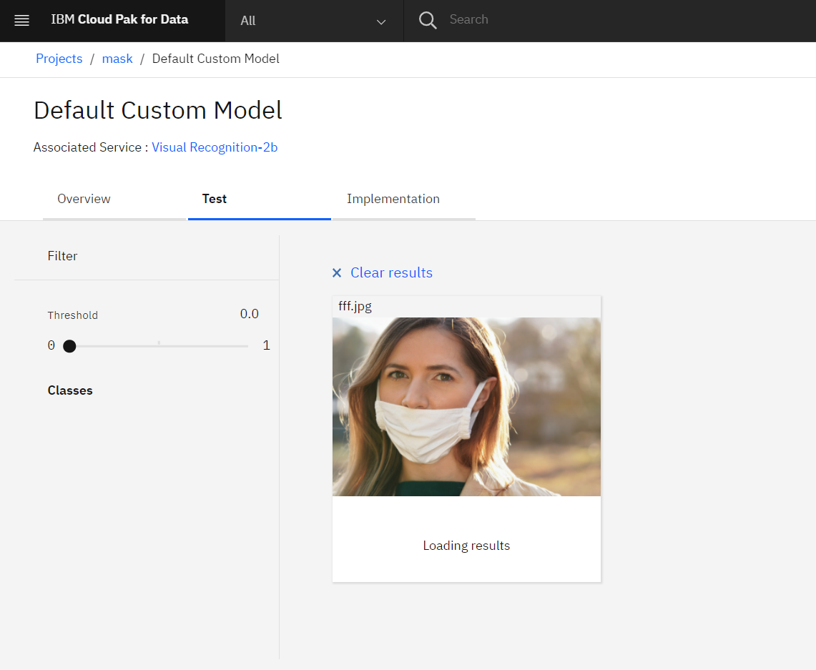
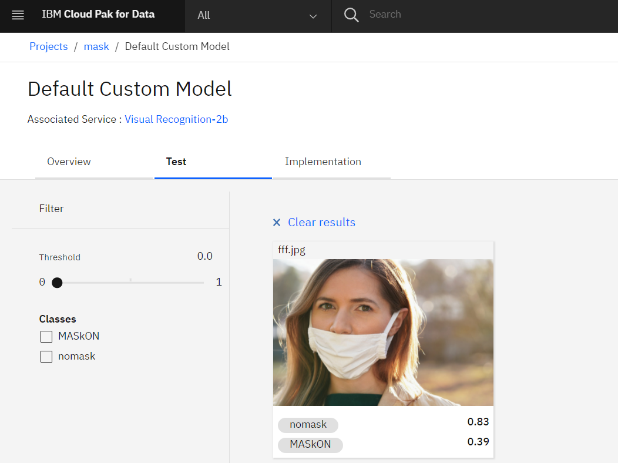
Mask Results

Slide 11
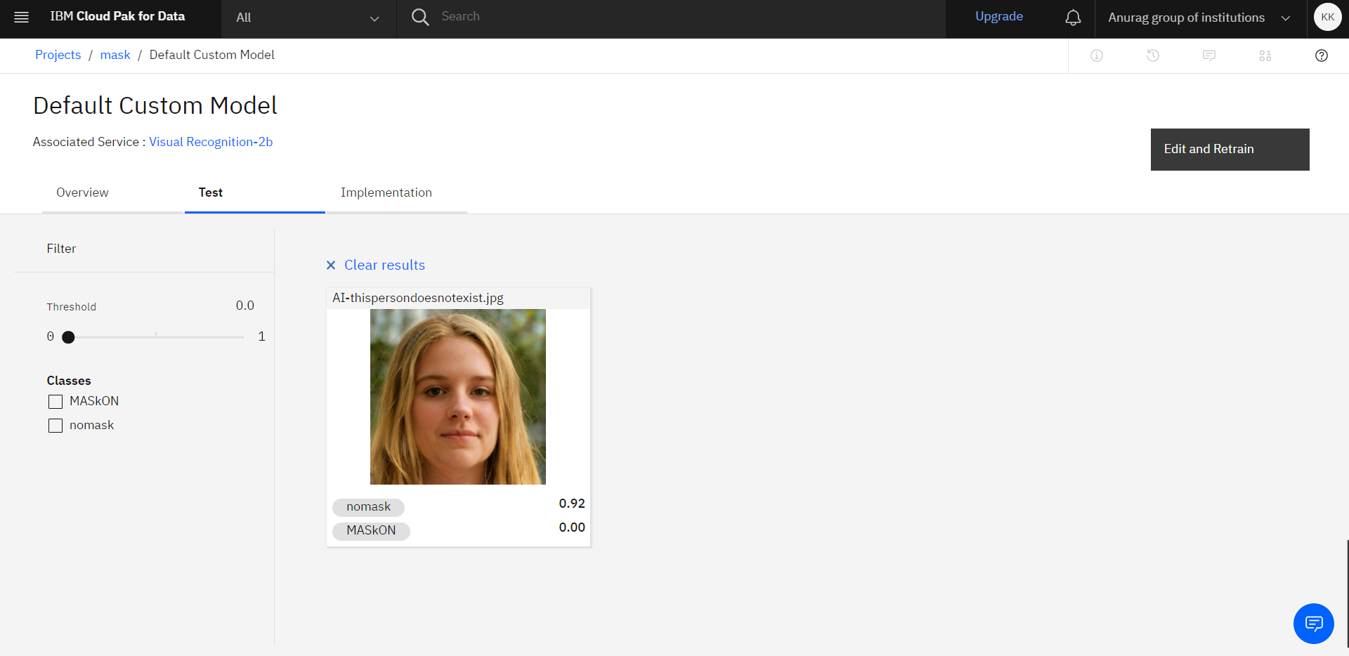
Mask Results

Slide 12
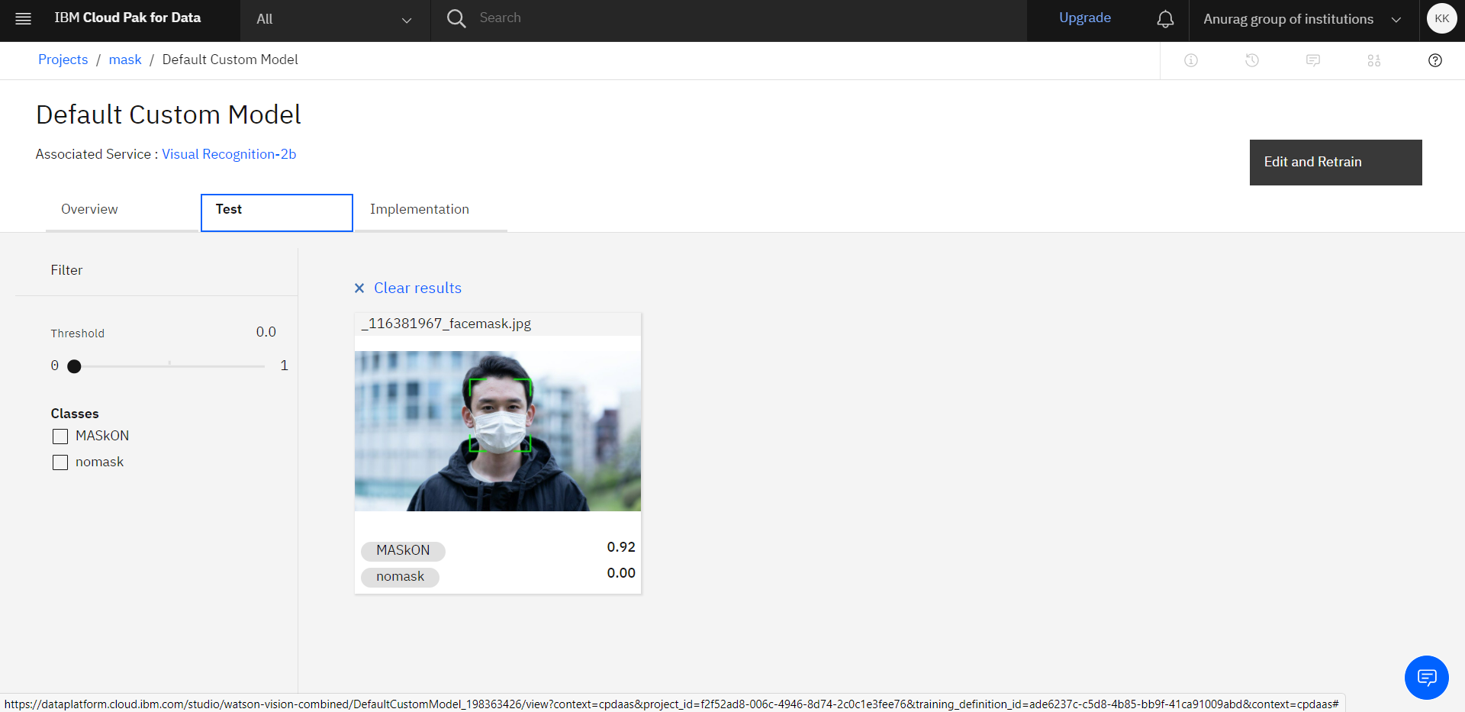
Mask results

Slide 13
Python code:
import time
import sys
import ibmiotf.application
import ibmiotf.device
import random
import json
#Provide your IBM Watson Device Credentials
organization = "mbkx9b“
deviceType = “IOTTemperature“
deviceId = "2021“
authMethod = "token“
authToken = “123456789“
# Initialize the device client.
T=0
H=0
while True:
T=23
H=45
#Send Temperature & Humidity to IBM Watson
data = {"d":{ 'temperature' : T, 'humidity': H }}
print data
def myOnPublishCallback():
print ("Published Temperature = %s C" % T, "Humidity = %s %%" % H, "to IBM Watson")
success = deviceCli.publishEvent("Data", "json", data, qos=0,
on_publish=myOnPublishCallback)
if not success:
print("Not connected to IoTF")
time.sleep(1)
deviceCli.commandCallback = myCommandCallback
# Disconnect the device and application from the cloud
deviceCli.disconnect()

Slide 14
import cv2
import json
from watson_developer_cloud import VisualRecognitionV3
visual_recognition = VisualRecognitionV3( '2018-03-19', iam_a-u5ql22-xgowd6qauj='ka42g8sMJUdBaRB13Kt8wadQbQKksbdm1mle7XA3Kixu’)
# Defining a function that will do the detections
def detect(gray, frame):
FaceFileName = "pic“
cv2.imwrite(FaceFileName, frame)
with open('./pic.jpg', 'rb') as
images_file:
classes = visual_recognition.classify(
images_file, threshold='0.6',
classifier_ids='Crop_1273797697').get_result()
data=json.dumps(classes, indent=2)
print(classes["images"][0]
["classifiers"][0]["classes"][0]["class"])
#print(data)
return frame
# Doing some Face Recognition with the webcam
video_capture = cv2.VideoCapture(0)
while True:
_,frame = video_capture.read()
gray = cv2.cvtColor(frame,
cv2.COLOR_BGR2GRAY)
canvas = detect(gray, frame)
cv2.imshow('Video', canvas)
if cv2.waitKey(1) & 0xFF == ord('q’):
break
video_capture.release()
cv2.destroyAllWindows()

Slide 15
THANK YOU!

